Slide 1
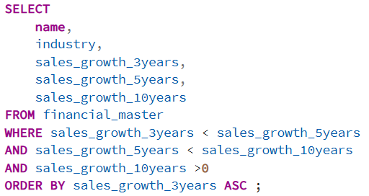
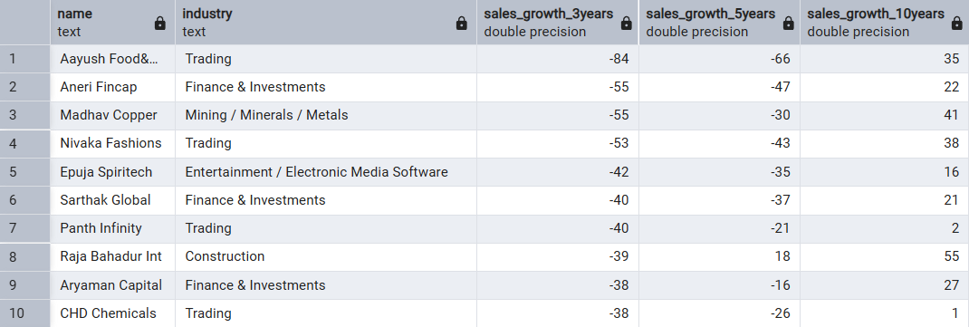
GROWTH TRENDS
Question 4: Compare sales growth across 3Y vs 5Y vs 10Y — which companies are showing growth deceleration (3Y > 5Y > 10Y) and which are accelerating?
Query
Output
Recommendation:
• Separate temporary slowdown from structural decline using quarterly trend analysis. • Focus on companies maintaining profitability despite slower growth. • Monitor whether growth stabilizes before making expansion decisions.
Observation:
• The identified companies show a clear slowdown pattern where recent 3-year sales growth remains weaker than longer-term historical growth. • Trading and Finance & Investments appear multiple times, indicating growth moderation across these sectors. • A few companies still maintain positive long-term growth despite declining short-term momentum.
Insight:
• Growth deceleration may indicate market maturity, weaker demand, or normalization after expansion periods. • Sector concentration suggests external industry conditions may be affecting recent performance more than company-specific factors. • Sustained slowdown could pressure future earnings expectations.

Slide 2
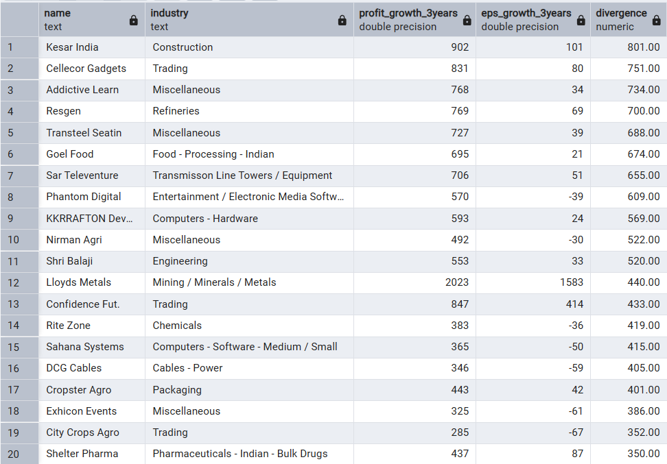
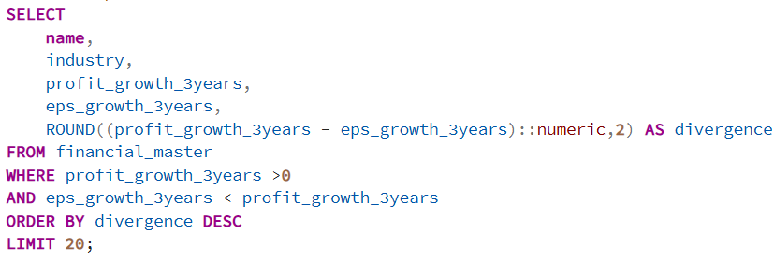
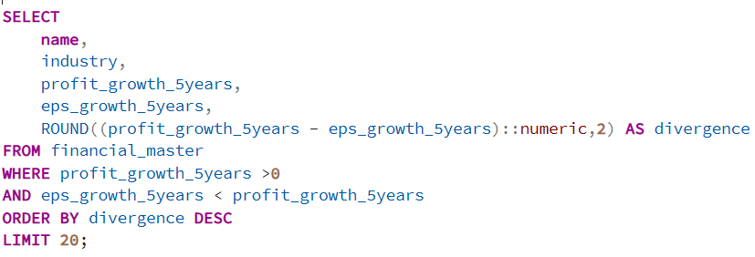
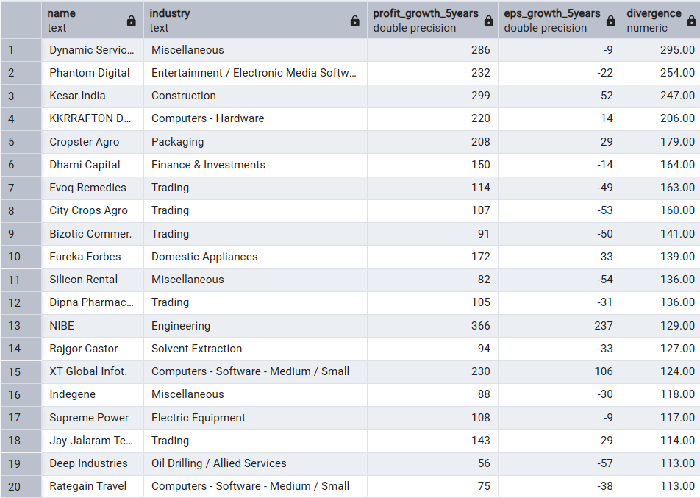
Question 5: Identify companies where Profit Growth and EPS Growth diverge — profit is increasing but EPS is not.
Insight:
• This pattern commonly indicates equity dilution, increase in share count, or non-operating profit contribution. • Rising profits without EPS expansion may reduce shareholder value creation quality. • Earnings growth alone may overstate actual investor returns.
Observation:
• Several companies show strong profit growth while EPS growth remains weak or negative, creating a significant gap. • The divergence appears across multiple sectors rather than being industry-specific. • Some cases indicate profits growing substantially without proportional shareholder earnings improvement.
Recommendation:
• Review share capital changes and dilution history. • Prioritize companies where EPS and profit growth move consistently together. • Validate whether profit growth is recurring and operational.

Slide 3
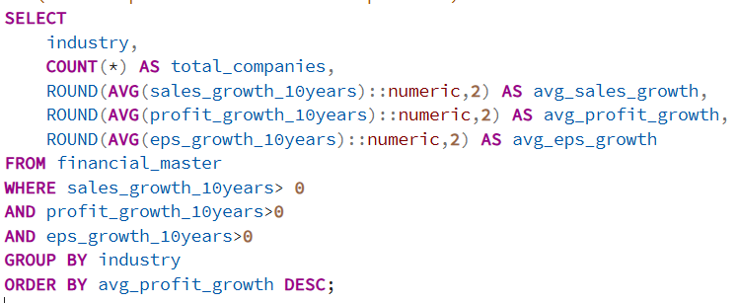
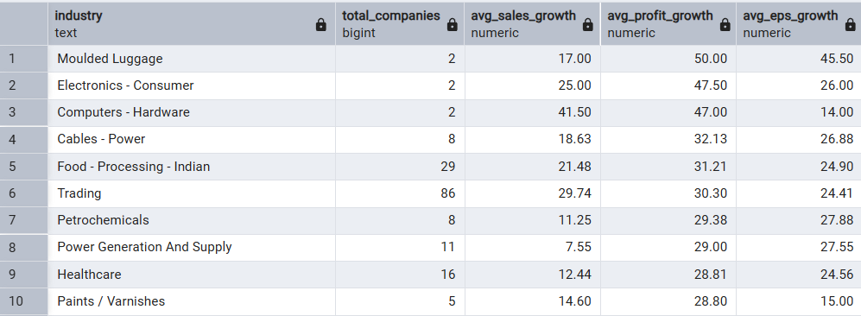
Question 6: Which sectors demonstrate sustainable 10-year growth (Sales + Profit + EPS all positive)?
Query
Output
Recommendation:
• Prioritize sectors showing balanced growth rather than revenue growth alone. • Compare valuation levels before investment decisions. • Perform deeper analysis on margin sustainability and capital efficiency.
Observation:
• Multiple sectors delivered positive growth across sales, profit, and EPS over the 10-year period. • Consumer, healthcare, industrial, and infrastructure-linked sectors appear repeatedly among sustainable growers. • Trading shows scale advantage with the largest company representation.
Insight:
• Consistent growth across all three metrics indicates balanced business expansion and stronger earnings quality. • Sectors delivering both profit and EPS growth are more likely creating shareholder value sustainably. • Long-term consistency generally reflects stronger business resilience.

